Slide 1


6 Tips for a Healthier YOU!

Slide 2


1. Drink more water
Most people are chronically dehydrated.
We often mistake thirst for hunger. If you feel hungry in between meals, try drinking a tall glass of water before you reach for a snack.
Add some flavor – Try a slice of lemon, orange, grapefruit, cucumber, mint get creative!
Keep bottled water in your bag or car.
Benefits? Increases yin, prevent premature aging, eliminate pain and headache, lessen hypertension and promote weight loss.

Slide 3
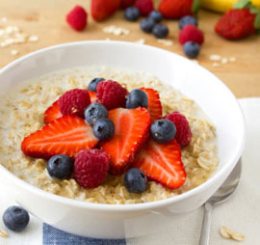
2. Eat Breakfast
The morning hours serves as a foundation for how our bodies respond for the remainder of the day. Our morning routines are critical in maximizing optimum body functioning.
Skipping meals cause your blood sugar to peak and dip, affecting your energy and mood. It can often cause over eating later on because you’re so hungry.
Easy Breakfast meal options:
Soak your steel cut oats overnight!
Smoothies! Green + added protein
Chia seeds soaked overnight

Slide 4

3. Get Moving
An Australian couple in their 60s ran a marathon every day in 2013. EVERY DAY!
"We are healthier, more physically fit and have unlimited energy at beyond 60 years of age than in our earlier years," they wrote on their website, RunningRawAroundAustralia.com
Keep it simple … But Consistent!
Make just 30 minutes of movement your daily goal.
Great exercise apps: Nike Training,
Nike Running, POPSUGAR Active.

Slide 5


4. Feed your Soul with Primary Foods
Friends, family, relationships, physical activity, spirituality and a satisfying career feed us. Lack of primary food creates over-reliance on secondary edible foods.
“Energy flows where intention goes”

Slide 6

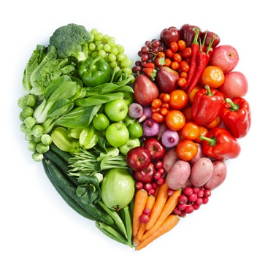
5. Eat a plant-based diet
Plant foods are typically lower in fat and calories and higher in filling fiber than meat, dairy, and processed foods, while providing loads of essential nutrients.
Get into the habit of adding green vegetables to your diet, the darker the better, as often as possible.
Mix Kale with your eggs, pasta, smoothies, sandwiches … Get creative in the kitchen!

Slide 7
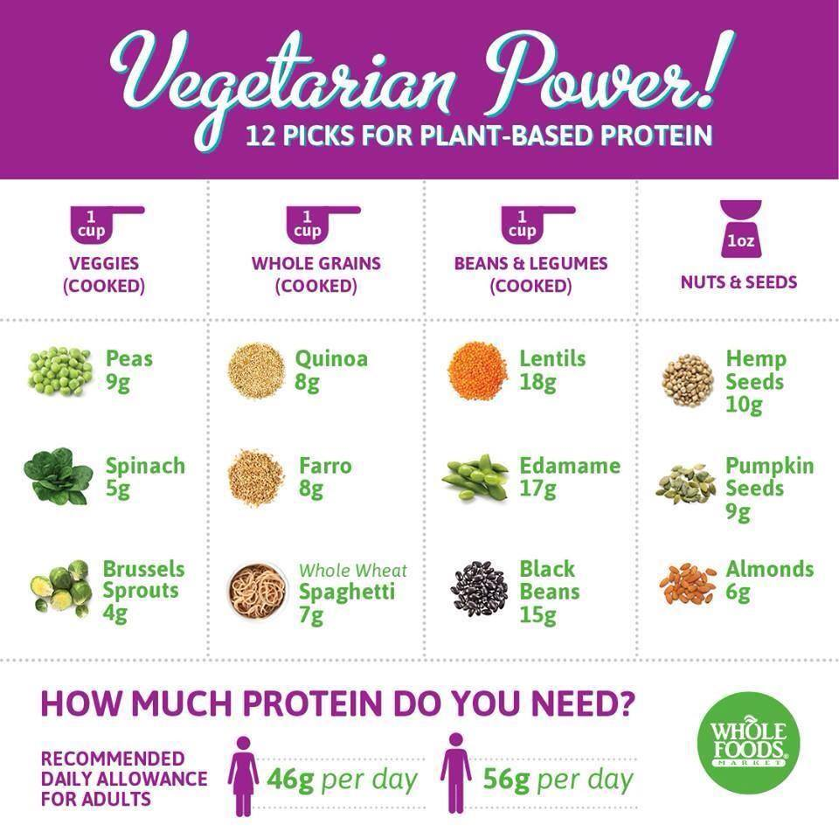
Protein Power!

Slide 8
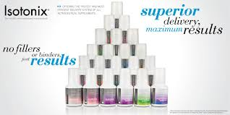
6. Supplement
Essential nutrients means our bodies do not make them therefore we must take them. With our food supply compromised with over harvesting, GMO’s, toxins and chemicals it’s essential to take proper form of supplementation to fill in the gaps so our bodies can continue to thrive in this complex world.
Isotonix products are formulated to deliver a concentrated solution of nutrients at the right rate for ultimate absorption.

Slide 9
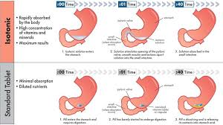
Isotonic vs. standard tablet

